Slide 1

Vel Tech Rangarajan Dr. Sagunthala R&D Institute of Science and Technology
School of Computing
Department of Computer Science and Engineering
10211CS224 / FULL STACK APPLICATION DEVELOPMENT (JAVA)
PROJECT REVIEW : MILESTONE PROJECT – 1
Date: 24-03-2026
Rational Expense Analytics Platform
SDG: SDG 8 - TrackWise: Analytics Platform
Presented By:
B.karthik Reddy – VTU24787 – Reg.No.23UECS1023
Courses Handling Faculty:
Dr.Hafizur Rahman – Assistant Professor

Slide 2
INTRODUCTION
1
TrackWise is a dynamic web-based application designed to help users track and analyze their daily expenses efficiently. Managing personal finances manually can lead to errors and lack of insights. This system uses database queries and web technologies to automate expense tracking. It allows users to store, retrieve, and analyze financial data in real time. The platform provides meaningful insights through categorized expense analysis. It improves financial awareness and decision-making. The system is scalable and accessible through web browsers. It demonstrates real-world application of full-stack development.
2
3
4
5
6
7
8
9

Slide 3

PROBLEM STATEMENT
1
Many individuals rely on manual methods or basic apps to track expenses, which lack analytical capabilities. This results in poor financial planning and lack of control over spending habits. Existing systems may not provide structured storage or real-time insights. There is a need for a simple, automated, and database-driven system. The system should efficiently manage expense data and generate meaningful analysis. It should also be user-friendly and accessible across devices. Hence, a dynamic web-based solution is required. TrackWise addresses these issues effectively.
2
3
4
5
6
7
8
9

Slide 4
OBJECTIVE(S)
To design and develop a simple web application to track daily expenses.
To implement a system that stores and manages expense data using MySQL.
To improve financial awareness by analyzing spending patterns.
To create dynamic web pages for easy interaction with users.
To evaluate user expenses and generate basic reports
1
2
3
4
5
6
7
8
9

Slide 5
PROPOSED SYSTEM
User-friendly interface for managing expenses
Secure login and user authentication system
Add, edit, delete expense records
Categorization of expenses (food, travel, etc.)
Real-time data storage using MySQL
Data retrieval using optimized SQL queries
Analytical insights through summaries and reports
Responsive design accessible on multiple devices
1
2
3
4
5
6
7
8
9

Slide 6
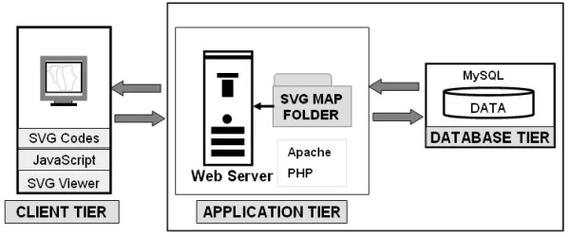
PROPOSED SYSTEM ARCHITECTURE
Explanation:
Input: User enters expense details (amount, category, date)
Processing: Server processes request using PHP/Node.js
Database: MySQL stores and retrieves expense records
Output: Displays reports, summaries, and analytics on web pages
1
2
3
4
5
6
7
8
9

Slide 7
WORKFLOW
USER
│
▼
[Login/Register]
│
▼
[Expense Input Module]
│
▼
[Processing & Validation]
│
▼
[Database (MySQL)]
│
▼
[Analytics & Reports]
│
▼
[Display Output]
│
▼
USER
1
2
3
4
5
6
7
8
9

Slide 8
TECHNOLOGIES USED
Frontend: HTML5, CSS3, JavaScript (ES6)
Backend: PHP / Node.js
Database: MySQL
Tools: XAMPP / Apache Tomcat / VS Code
Hardware/Software Requirements:
System with 4GB RAM minimum
Web browser (Chrome/Edge)
Local server (XAMPP/WAMP
1
2
3
4
5
6
:
7
8
9

Slide 9
MODULE DESCRIPTION
Module 1: User Management Handles user registration, login, and authentication securely.
Module 2: Expense Management Allows users to add, edit, delete, and categorize expenses.
Module 3: Database Management Manages storage, retrieval, and integrity of expense data using MySQL.
Module 4: Analytics & Reporting Generates summaries and insights like total spending and category-wise analysis.
1
2
3
4
5
6
7
8
9

Slide 10
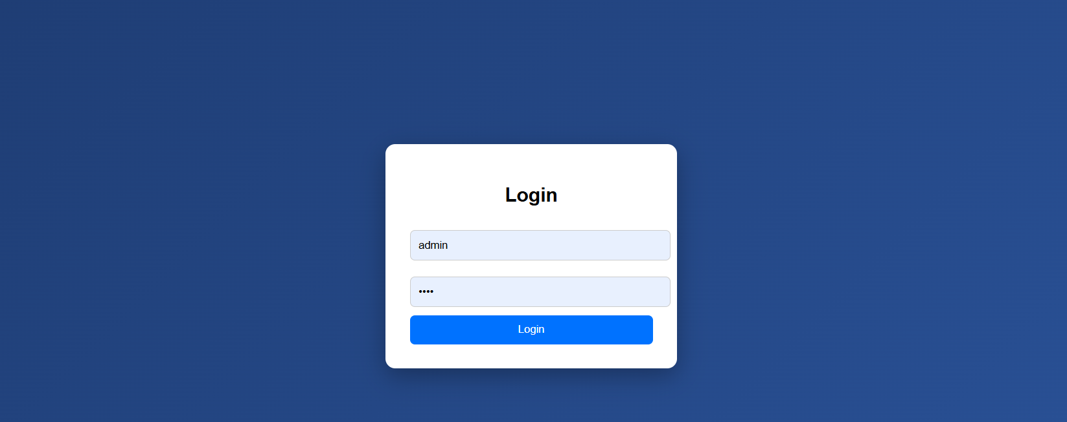
IMPLEMENTATION SCREENSHOTS
1
2
3
Login Page :
A login page allows users to securely access their account by entering their username and password.
It ensures authentication and protects personal data from unauthorized access.
4
5
6
7
8
9

Slide 11
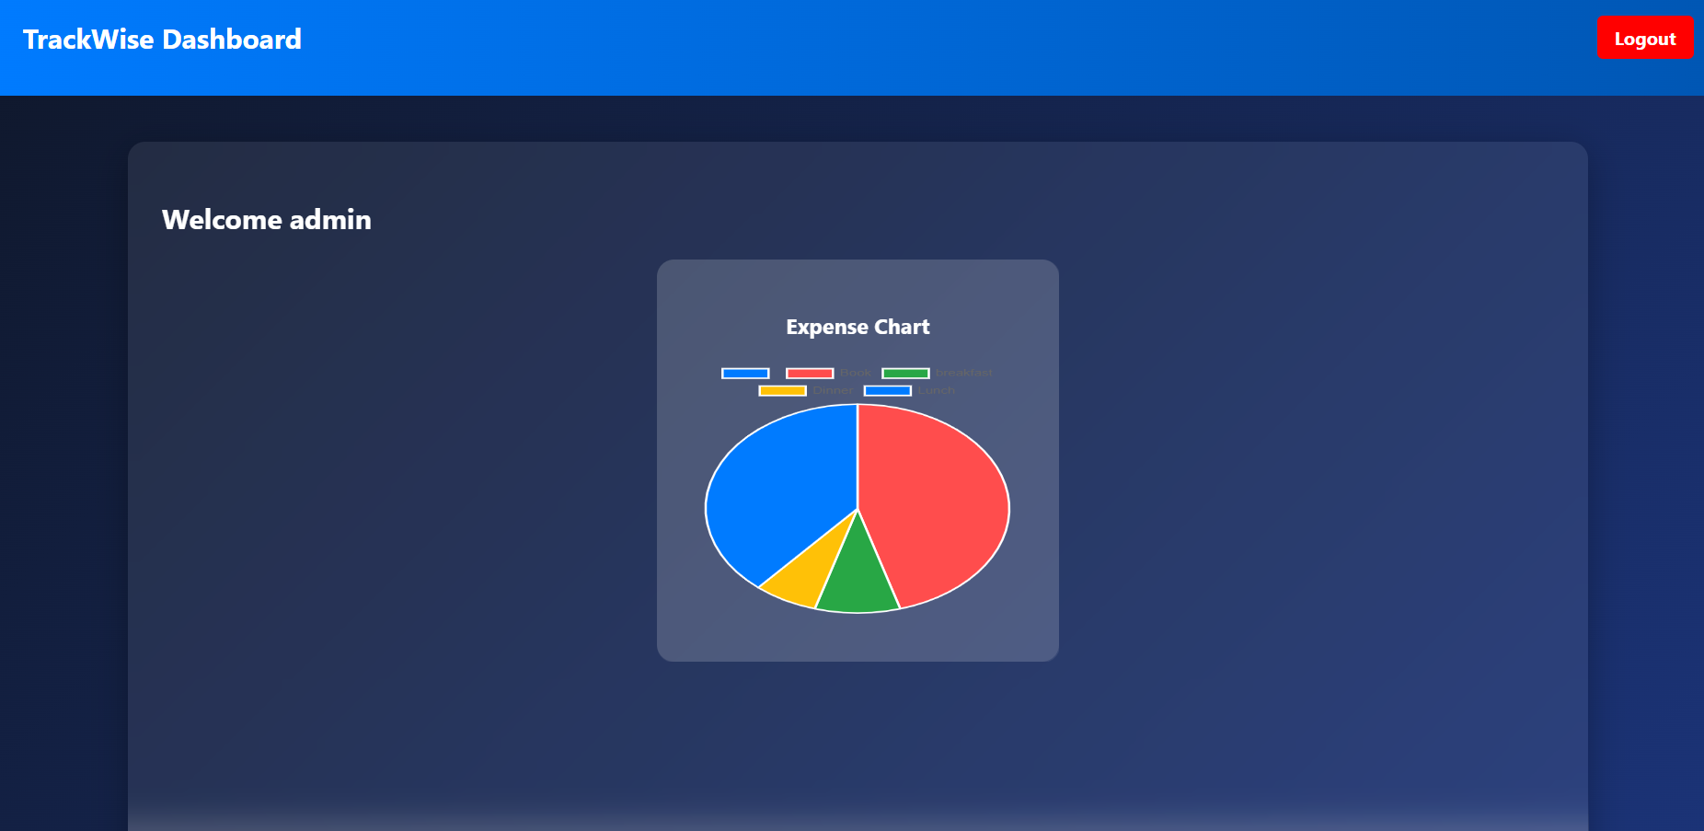
IMPLEMENTATION SCREENSHOTS
1
2
3
4
Expense Chart :
The TrackWise Dashboard provides a clear overview of user expenses with a visual chart for easy analysis.
It helps users monitor spending patterns and manage their finances efficiently in one place.
5
6
7
8(A)
9

Slide 12
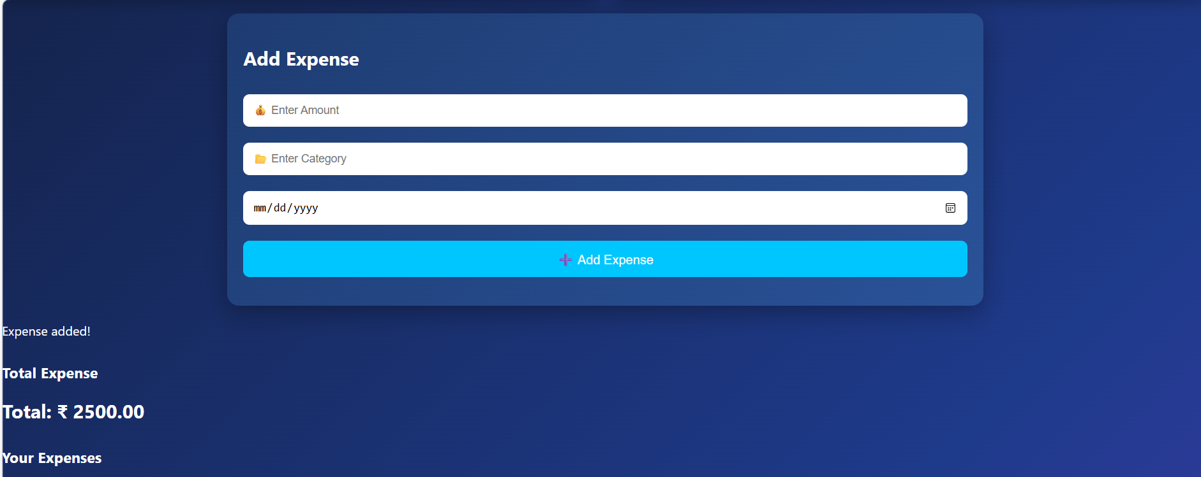
The Add Expense page allows users to record their spending by entering amount, category, and date. It updates the total expenses and helps track financial activities efficiently.
IMPLEMENTATION SCREENSHOTS
1
2
3
4
5
6
7
8(B)
Add Expense
The Add Expense page allows users to record their spending by entering amount, category, and date.
It updates the total expenses and helps track financial activities efficiently.
9

Slide 13
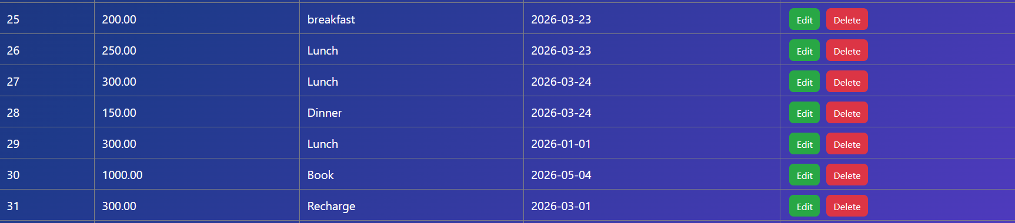
IMPLEMENTATION SCREENSHOTS
1
2
3
4
5
6
7
Out Put :
This section displays a list of all recorded expenses with details like amount, category, and date.
It allows users to easily manage entries by editing or deleting them as needed.
8(C)
9

Slide 14
Thank you

